Slide 1
Final Team Project Fall 2018
Retail DW & BI Project

Slide 2
SOR Retail Company SOR - FALL 2018
Database | SOR Target | Backup Files
Retail_SOR_NA | Oracle | retail_sor_na_sqlserver.zip (use SQL Server backup & run Talend) Talend_Migrate_RETAIL_SOR_NA_MSSQL_to_ORCL.zip
Retail_SOR_EU | SQL Server | retail_sor_eu_sqlserver.zip (SQL Server)
Retail_SOR_AS | MySQL | retail_sor_as_mysql.zip
Retail_SOR_CAT | Azure SQL | retail_sor_cat_azure.bacpac
Retail_SOR_PLAN | PostgreSQL | retail_sor_plan_postgresql.sql
Flat Files

Slide 3
Retail Company – SOR Table Row Counts
Updated 12/1/2018

Slide 4
Grading Criteria – Talend
Updated 12/6/2018
Three levels for completing data integration (Talend):
Load all dimensional data & facts for 2014
Load all dimensional data & facts for 2012-2014
Load all dimensions & facts – This is a BONUS level
For any levels (above) completed:
Need one “master” job that loads data
Provide processing time with query from [DW_CNTL].[dbo].[cntl_JobStats] (or [DW_CNTL].[dbo].[cntl_statCatcher]) listing rootPID job and all children jobs
Provide table row counts & sales amount by USD (where applicable)
Provide table row counts for reject tables – total rows & row counts by reject reason

Slide 5
Grading Criteria – SSIS
Updated 12/6/2018
Two levels for completing data integration (SSIS):
Load all dimensional data & facts for 2014
Load all dimensional data & facts for 2012-2014 – This is a BONUS level
For any levels (above) completed:
Need one “master” job that loads data
Provide processing time
Provide table row counts

Slide 6
Grading Criteria – Tableau
Updated 12/6/2018
Three levels for Dashboards & Visualizations
facts from 2014 & related
Load all dimensional data & facts for 2012-2014
Load all dimensions & facts – This is a BONUS level
For any levels (above) completed:
Need one “master” job that loads data
Provide processing time with query from [DW_CNTL].[dbo].[cntl_JobStats] (or [DW_CNTL].[dbo].[cntl_statCatcher]) listing rootPID job and all children jobs
Provide table row counts
Provide table row counts for reject tables – total rows & row counts by reject reason

Slide 7
Source Systems - Notes
Final Team Project

Slide 8
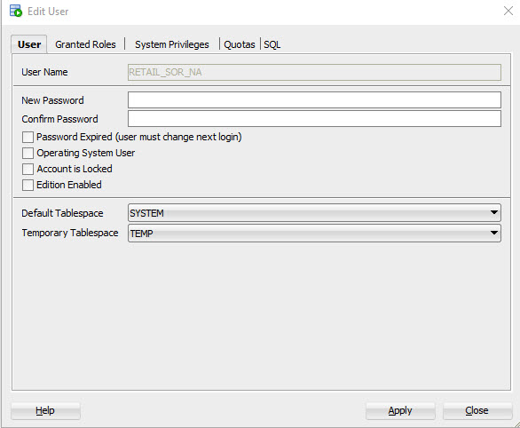
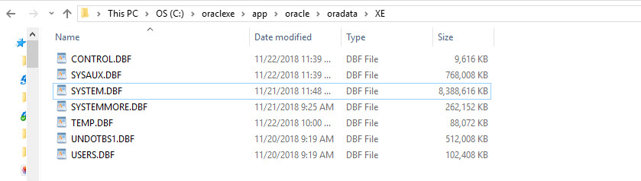
Retail_SOR_NA – SQL Server to Oracle Migration
Create Oracle Retail_SOR_NA database
Need to increase size of SYSTEM tablespace:
ALTER DATABASE DATAFILE 'C:\oraclexe\app\oracle\oradata\XE\system.dbf' RESIZE 8g;
Run script to create tables: retail_sor_na_orcl_Create_Tables_20181119.sql

Slide 9
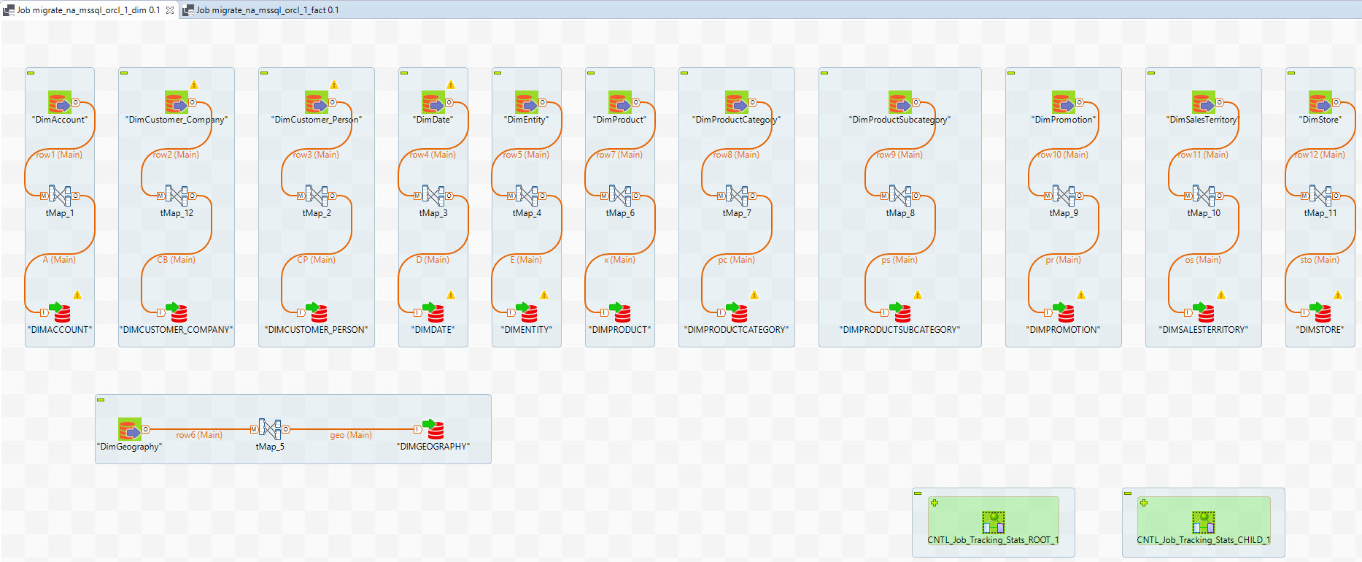
Retail_SOR_NA – SQL Server to Oracle Migration

Slide 10
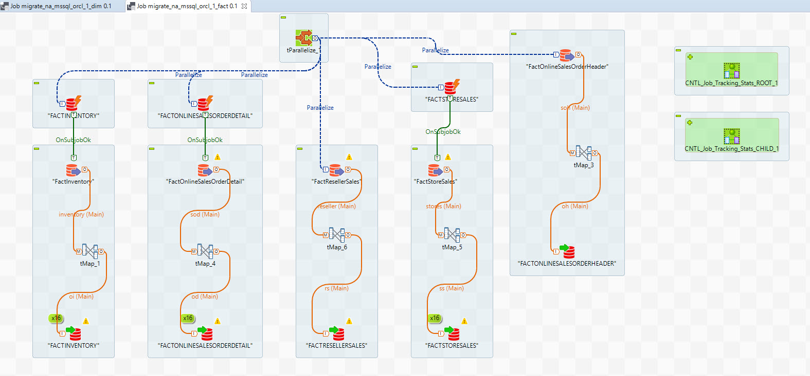
Retail_SOR_NA – SQL Server to Oracle Migration

Slide 11
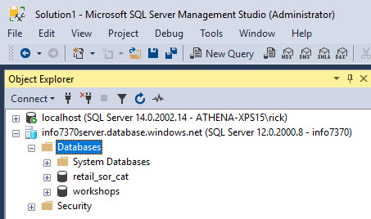
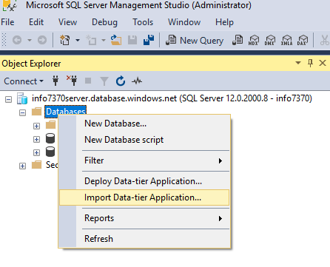
Retail_SOR_CAT – Azure SQL
Azure SQL Backup - retail_sor_cat_azure.bacpac
Login to your Azure SQL server
Right click on Databases & select Import Data-Tier Application

Slide 12
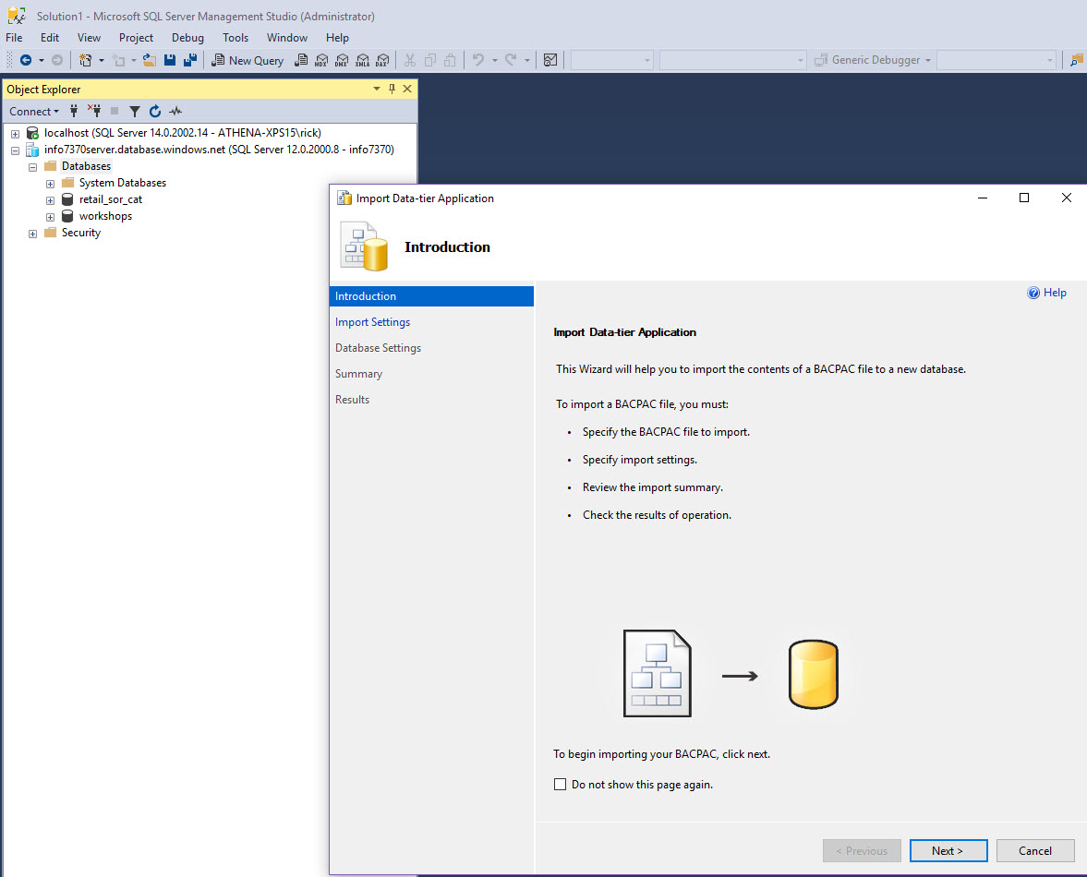
Retail_SOR_CAT – Azure SQL

Slide 13
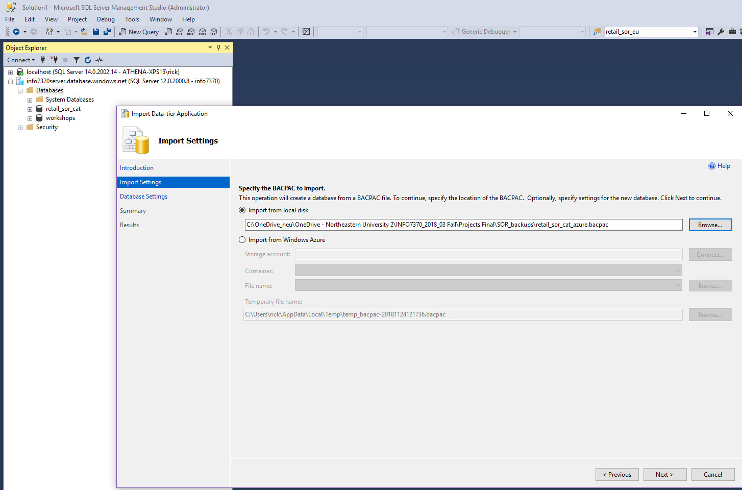
Retail_SOR_CAT – Azure SQL
The Azure backup file is on OneDrive. Use, of, course, whatever your file location is.

Slide 14
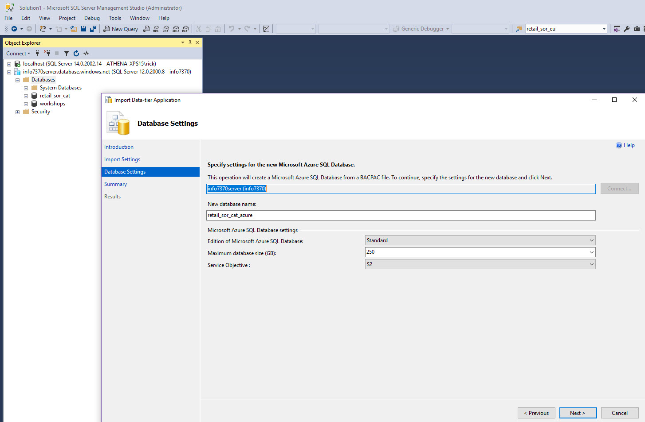
Retail_SOR_CAT – Azure SQL
Input a new database name.
Use Retail_SOR_CAT (note: I added suffix _Azure because I already had this db created & loaded via Talend)

Slide 15
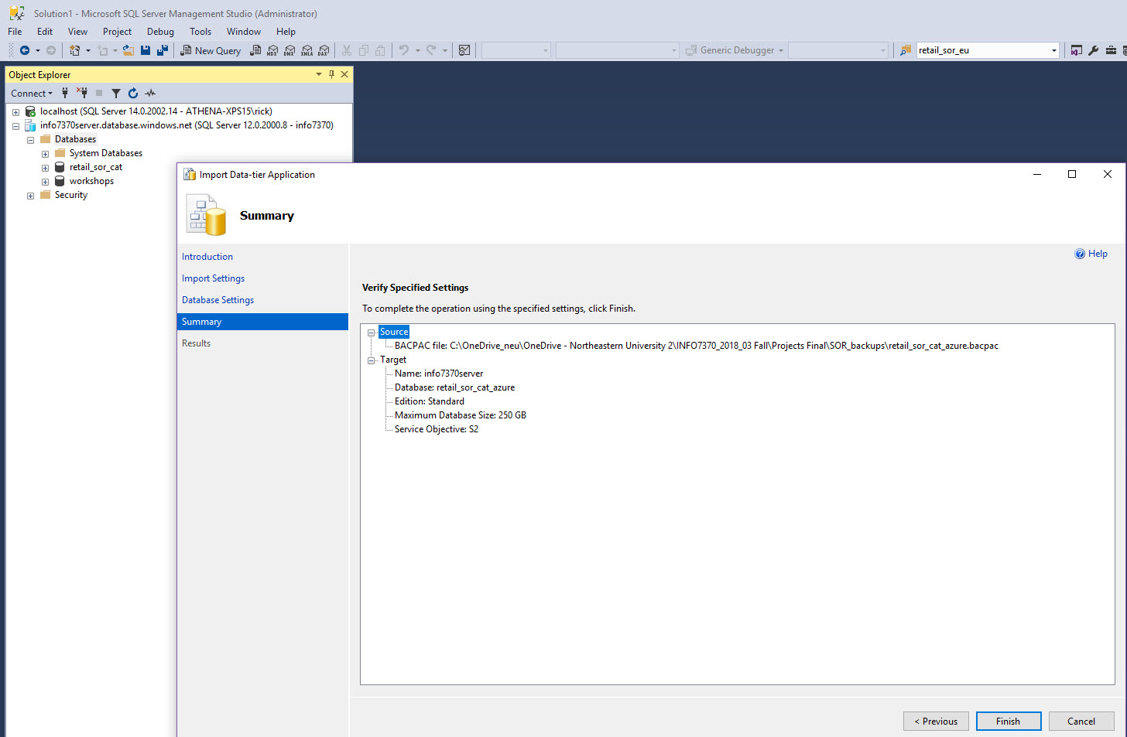
Retail_SOR_CAT – Azure SQL
Select Finish
You should see you db deployed on Azure Portal

Slide 16
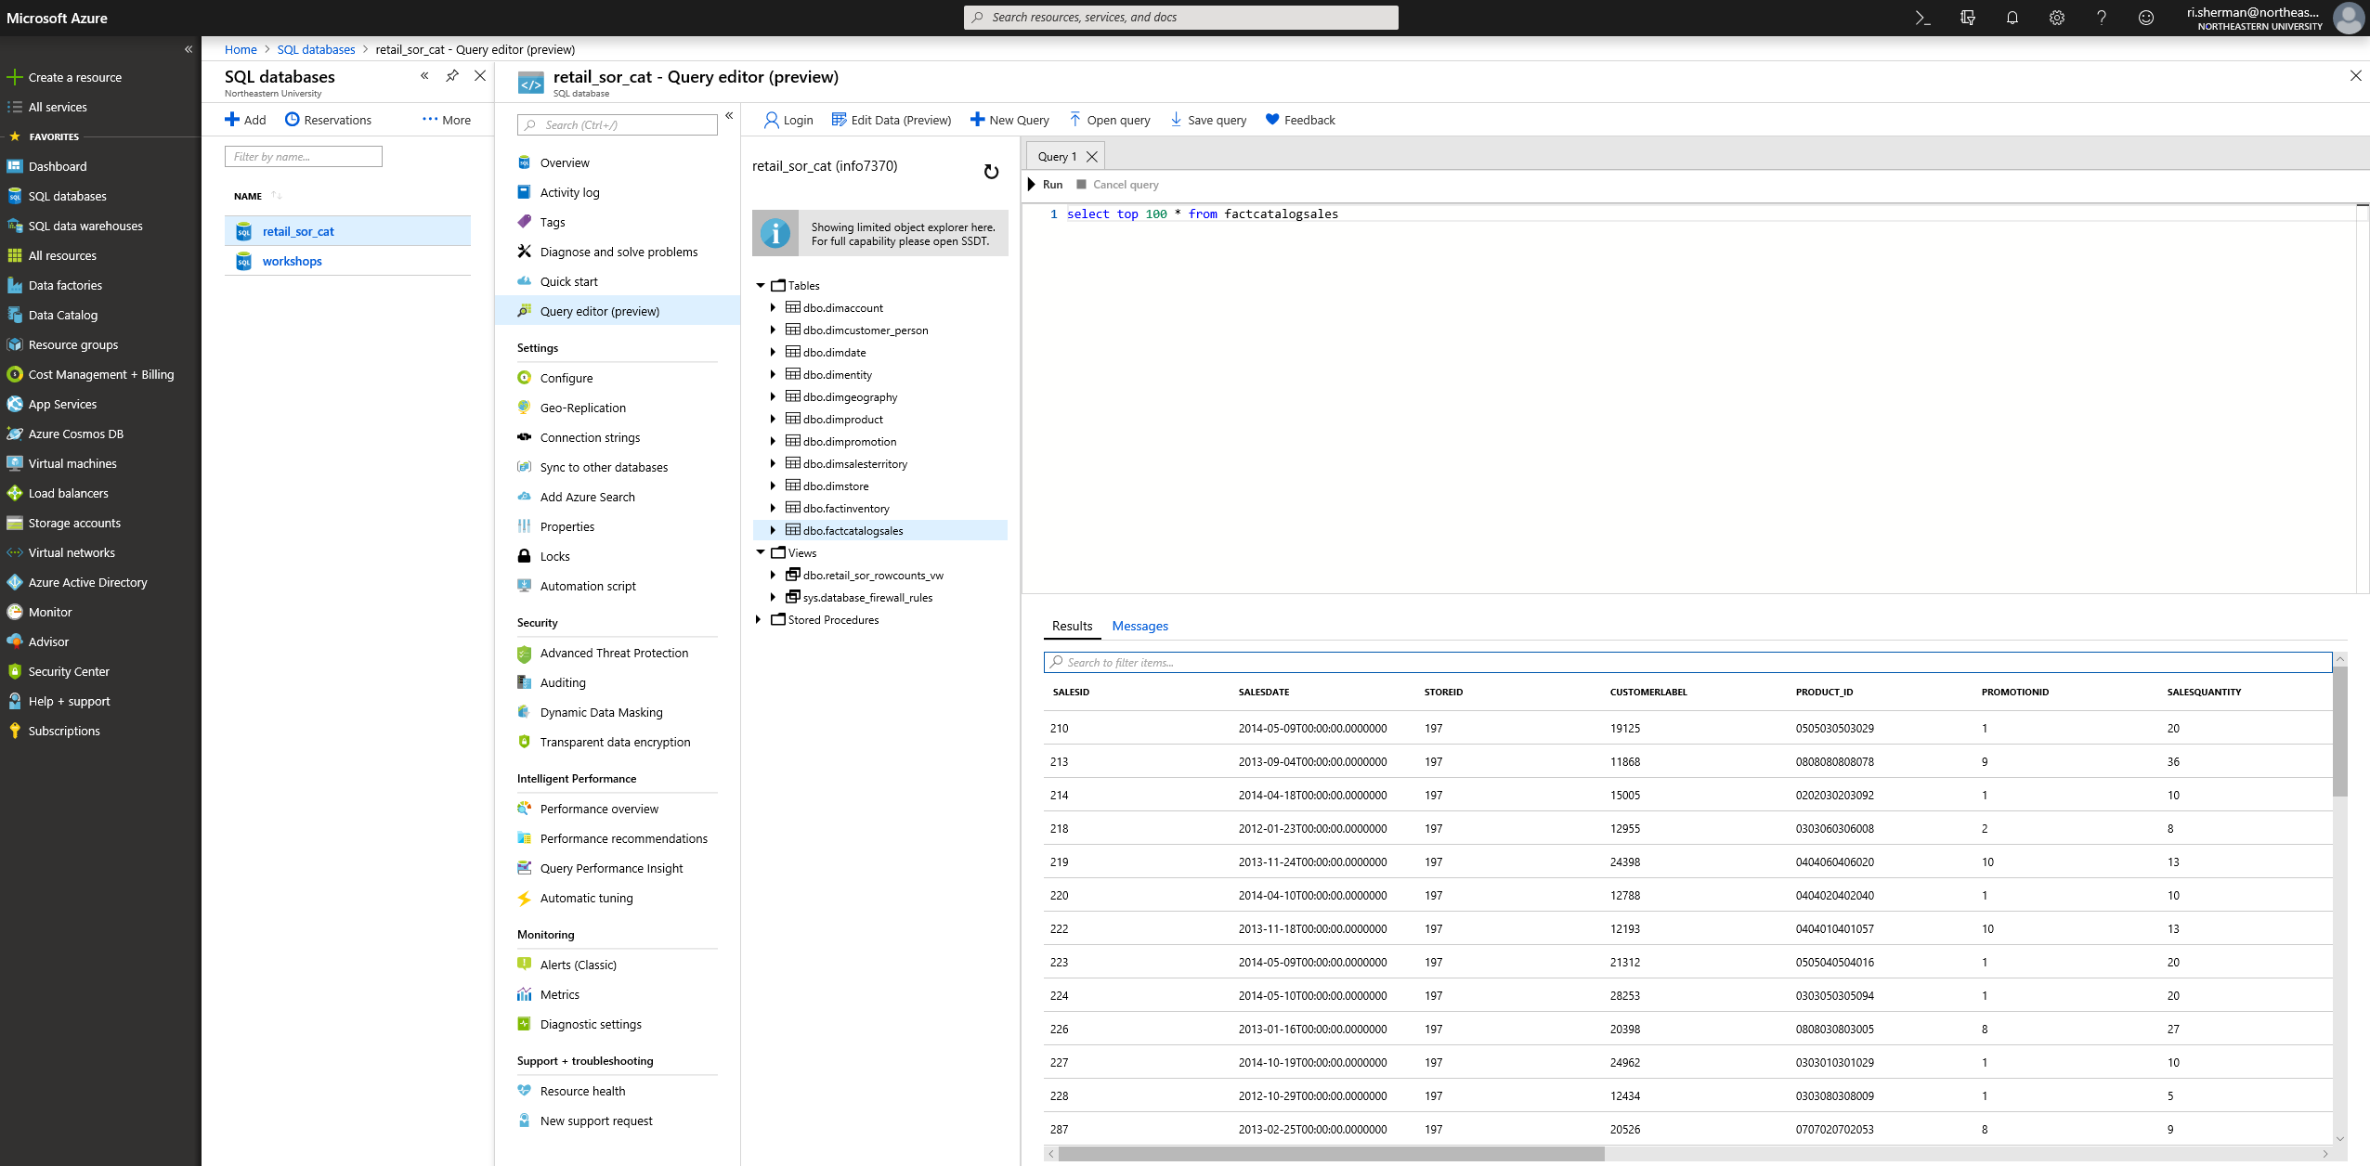
Retail_SOR_CAT – Azure SQL
Azure Portal – work with SQL db

Slide 17
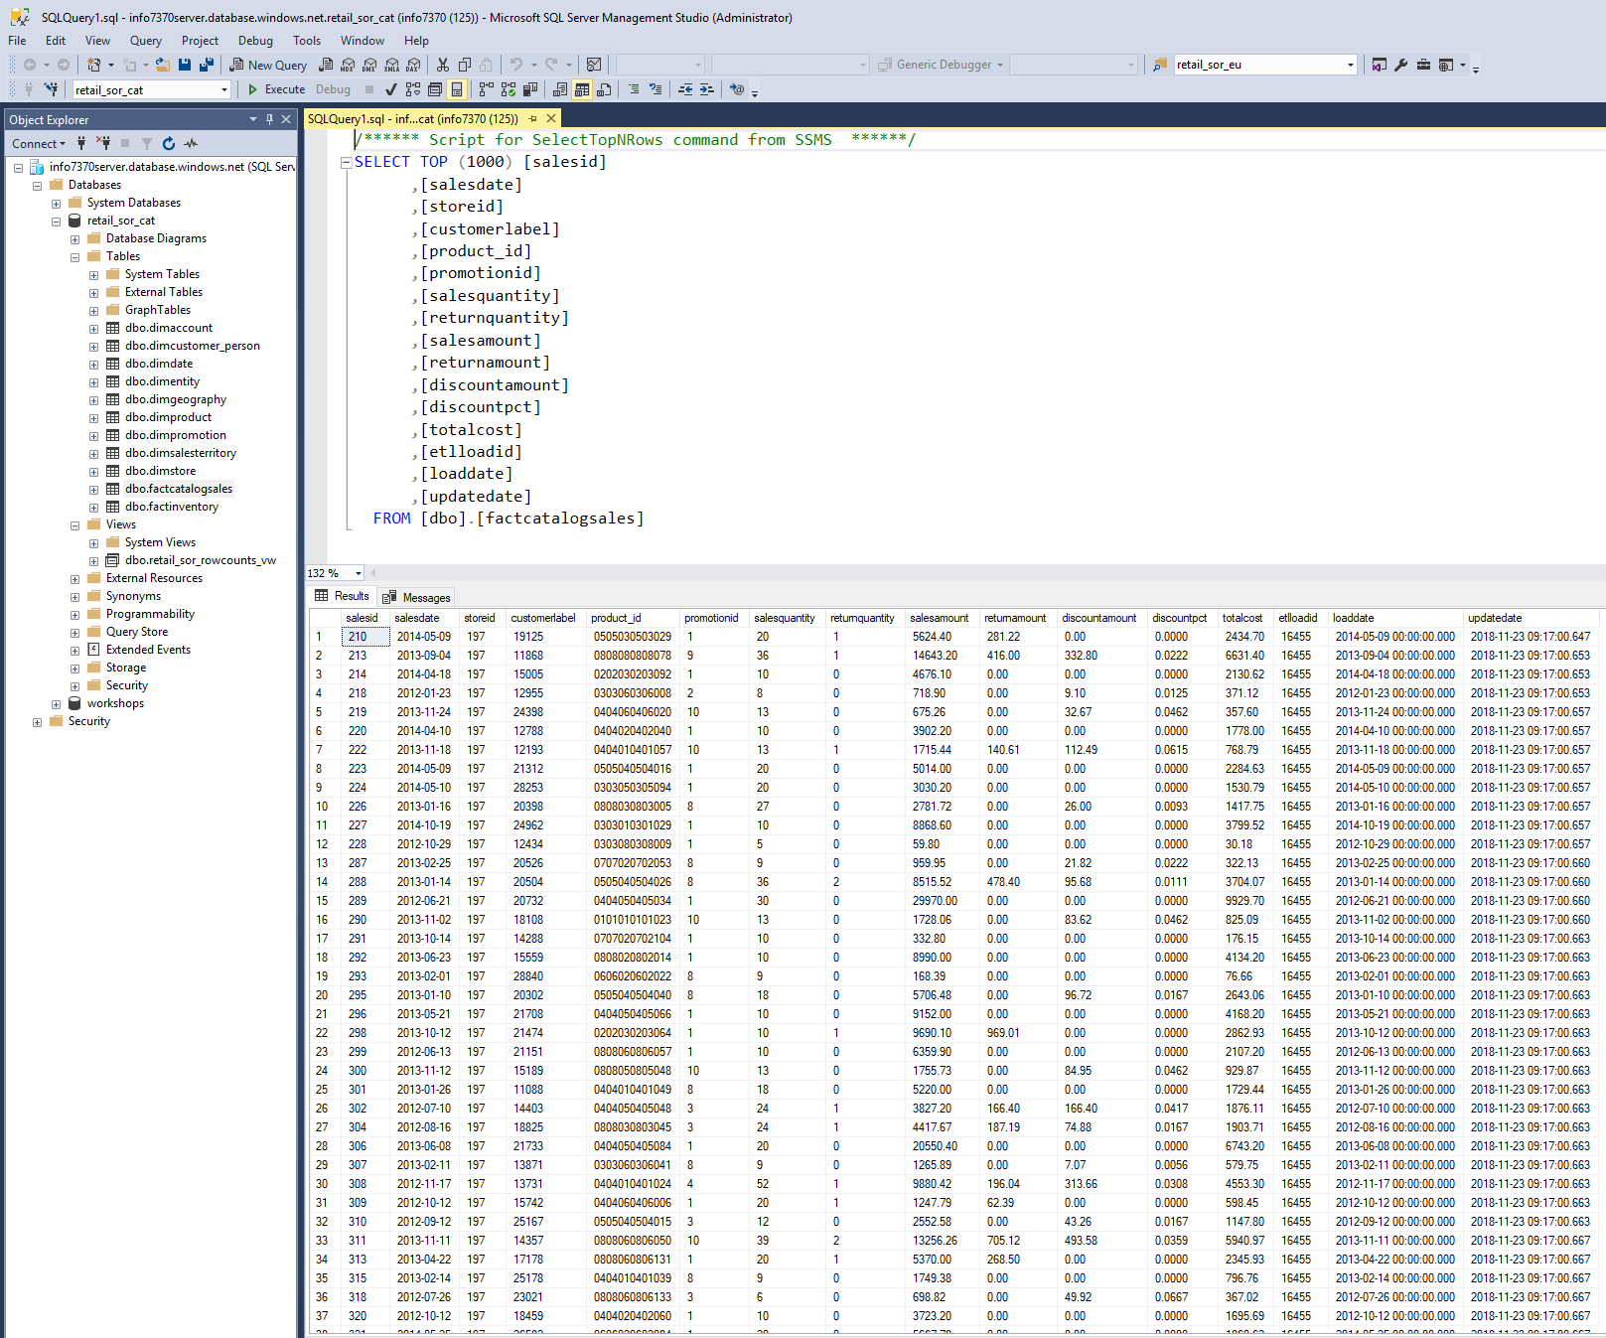
Retail_SOR_CAT – Azure SQL
SSMS connected to Azure Server & databases is alternative to Azure Portal

Slide 18
Retail DW
Final Team Project

Slide 19
Overview
This project involves a retail company that sells a variety of products to people and to businesses across a variety of sales channels.
The Retail Company would like to:
Create a data warehouse (DW) from its various systems of record (SORs)
Create BI applications that enable analysis of business performance
The DW will store (facts) in the following subject areas:
Sales
Inventory
Sales Quotas
Strategy Plans

Slide 20
Retail Company
The categories of products sold:
Audio
TV and Video
Computers
Cameras and camcorders
Cell phones
Music, Movies and Audio Books
Games and Toys
Home Appliances
The Retail Company would like to:
Create a data warehouse (DW) from its various systems of record (SORs)
Create BI applications that enable analysis of business performance

Slide 21
Retail Company
The company has 4 sales channels:
Retail
Stores
Catalog
Online
Three top-level geographic regions:
North America
Europe
Asia
Customers who purchased products are tracked in:
Catalog
Online

Slide 22
Systems of Record (SORs)
SORs have prices, costs & sales in “continent” currency
North America & Catalog Operations – US Dollars (USD)
Europe - Euro (EUR)
Asia - China Yuan (CNY)
Quota & Plan has data in local or “continent” currency
DW has prices, costs & sales:
In USD
In “local” currency used in SOR
Prices, costs & sales are in “constant” currency, i.e. recorded using published unit prices & costs
Daily currency exchange rate should be used in converting Euro & Yuan to USD

Slide 23
Systems of Record (SORs)
Unit Prices & Costs were changed during 2012-3016
You need to create SCD dimension for both Unit Price & Unit Cost Dimensions.
Step 1 – initial unit prices or costs
Step 2-n – prices or costs revised
Unit Prices & Unit Costs should NOT stores in Sales related tables nor in the Product dimension

Slide 24
Systems of Record (SORs)
DW sales related tables
FactSales – contains data for all 4 sales channels
FactOnlineSales – contains Online sales channel only and has customer data
Sales Quotas & Strategy Plan:
Have data for three scenarios
Actuals
Budget – from SORs directly
Forecast – from SORs directly
Data granularity is monthly
For Sales Quota need to aggregate actual sales data to populate Actuals scenario
For Strategy Plan need to aggregate data for actuals in 2 accounts:
AccountKey = 4 ‘Sale Revenue’ - sales
AccountKey = 5 ‘Cost of Goods Sold’ – total product cost

Slide 25
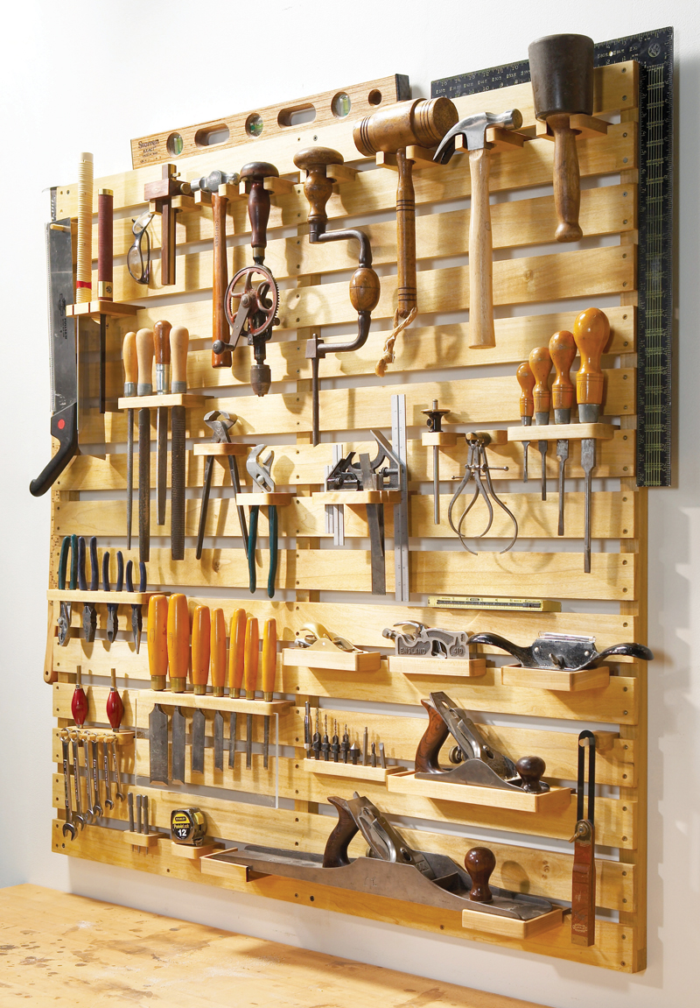

Final Team Project
Sourcing Requirements

Slide 26
Deliverables
DW has dimensional model to support:
Sales analysis
Inventory analysis
Sales quota & planning analysis
DI -- Load data sources into DW
SOR: TBD
DW: TBD with ETL: Talend
DW: TBD with ETL: SSIS

Slide 27
Deliverables
BI -- Develop BI Dashboards, Reports & Visualizations analysis
Sales analysis
Inventory analysis
Sales quota & planning analysis

Slide 28

Deliverables - BI
BI Tools:
Tableau Desktop
Microsoft Power BI
Deliverables:
Dashboards with visualization for each analysis & for each BI tool
Comparison of each tool – key differences – strengths & weaknesses

Slide 29
Final Team Project
Deliverables

Slide 30
Deliverables - DI
Use Talend Enterprise Data Integrator to DW
Use SSIS to DW (TBD)
Load DW from data sources
Document all jobs
Provide load statistics
Provide analysis of load jobs using one of BI tools used in this project
Handle data quality & error messages
Document error handling results
Load rejection records
Track reasons for rejections
Provide analysis of rejections & reasons using one of BI tools used in this project
Note: Follow project standards

Slide 31
Deliverables – Data Integration
Table Row Counts
Total Rows - Dimensions, Facts & Reject Tables
Row counts by region (SOR source) - Dimensions, Facts & Reject Tables
Row counts by reject reason – Fact Tables
Sales Amounts (USD)
By Region
By Channel (Internet versus Store)
Time to load DW
Note: Need one root job that loads all sources – databases and files

Slide 32
Deliverables – Analysis
Data Subjects:
Online Sales (FactOnlineSales)
Online & Catalog both have customers
Sales (FactStoreSales)
All four sales channels
Inventory (FactInventory)
Sales Quota
Strategy Plan
Types of analysis:
Trending
Ranking
Comparison
Period over Period
Geo Map
Contribution
Measures:
Sales $, Profit, Profit Margin, Avg Order Size,…
Dimensions:
Customers: Company & Person, demographics
Product: Product Hierarchy (Category, Subcategory, Product), Brand, other attributes
Store: Type, other attributes
Dates
Geography

Slide 33
Online Sales Analysis
Fact: FactOnline Sales
Dimensions: Customer, Store, Product, Promotion, Sales Territory, Geo – Sales (or Store) & Customer
Measures: Sales, Cost, Profit, Profit Margin, etc.

Slide 34
Online Sales Analysis
Product sales analysis
Contribution, Ranked (Top x)
Product Hierarchy, Brand
Sales by time
Period over Period analysis
Trends
Customer sales analysis
B2C - demographics such as education, income, etc. & geo
B2B – by annual sales, geo
Sales Analysis by Geography
Promotion Analysis - Impact of sales & margin with promotions

Slide 35
Overall Sales Analysis
Fact: FactStoreSales
Dimensions: Channel, Store, Product, Promotion, Sales Territory, Geo – Sales (or Store)
Measures: Sales, Cost, Profit, Profit Margin, etc.

Slide 36
Sales Analysis
Channel sales analysis
Contribution
Trends
Product sales analysis
Contribution, Ranked (Top x)
Product Hierarchy, Brand
Sales by time
Period over Period analysis
Trends
Sales Analysis by Geography
Promotion Analysis - Impact of sales & margin with promotions

Slide 37
Overall Sales Analysis
Fact: FactStoreSales
Dimensions: Channel, Store, Product, Promotion, Sales Territory, Geo – Sales (or Store)
Measures: Sales, Cost, Profit, Profit Margin, etc.

Slide 38
Reject Analysis
Facts: FactSales, FactOnlineSales, FactInventory
Analysis by Region SOR and/or by Source Table
Row counts & type of rejects

Slide 39
Sales Quota & Strategy Plan Analysis
Facts: FactSalesQuota, FactStrategyPlan, FactSales
Scenario: Budget, Forecast, Actual (from FactSales)
Analysis
Compare Budget, Forecast & Plan
By product or Product Category
By store & geography

